Slide 1


GE107 : TINKERING LAB
GROUP PROJECT

Slide 2
GROUP MEMBERS
1.ADITYA (2023CEB1022)
2.AMEEN KALER (2023CEB1023)
3. MANSHU (2023CEB1040)
4. SHUBHAM (2023CEB1048)
5. YOGESH KUMAR (2023CEB1055)

Slide 3


Overview
PROBLEM STATEMENT
04
REQUIREMENTS
05
OBJECTIVE
06
PROJECT PLAN
07
CONTRIBUTION OF EACH MEMBER
10
FUTURE PLANS FOR THE NEXT WEEK
12
SUMMARY
13

Slide 4

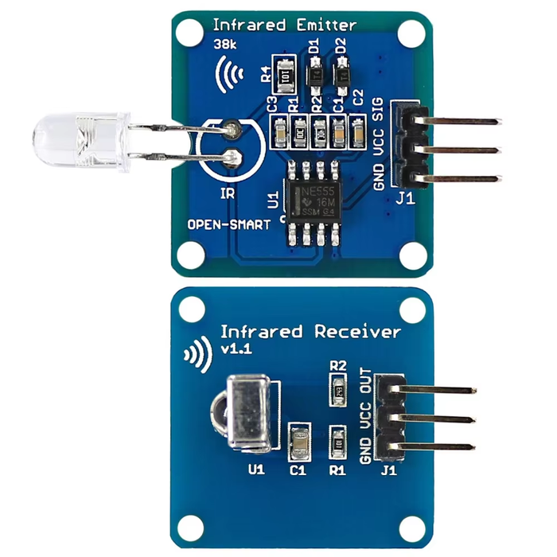

IR BLASTER WITH (ALEXA/GOOGLE ASSISTANT)
PROBLEM STATEMENT :-
The objective of this project is to develop an Arduino-based IR blaster system that
can be controlled using voice commands via Alexa or Google Assistant. The
system will utilize Arduino microcontroller technology along with an IR Treansmitter
module and Wi-Fi connectivity to enable users to remotely control infrared devices
such as TVs, air conditioners, and audio systems using voice commands.

Slide 5
REQUIREMENTS
Arduino Board
IR Transmitter Module: Integrate an IR transmitter module (e.g., TSOP38238) with the Arduino to emit infrared signals for controlling various IR devices such as TVs, air conditioners, or audio systems.
Wi-Fi Module: Incorporate a Wi-Fi module (e.g., ESP8266 or ESP32) with the Arduino to enable internet connectivity and communication with Alexa or Google Assistant.
Alexa Skills/Google Actions Integration: Develop software integration with Alexa Skills or Google Actions to enable voice control of the IR blaster system via Alexa or Google Assistant-enabled devices.
Power supply

Slide 6


PROJECT OBJECTIVE
The Objective of this project is to make an Arduino-based IR blaster system that allows users to control IR-enabled devices (like TVs, air conditioners, and audio systems) using voice commands via Alexa or Google Assistant. The system integrates an IR transmitter module with an Arduino microcontroller, a Wi-Fi module for internet connectivity, and custom software to interface with Alexa or Google Assistant-enabled devices.

Slide 7
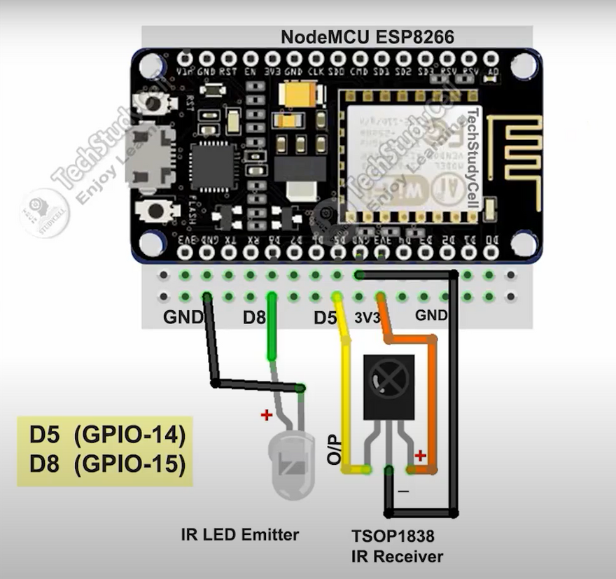
Project Plan
In the project,after getting all the components we make the system setup and do the programming as follows:
Circuit design and Assembly
IR TRANSMITTER CIRCUIT: Connect the IR LED to the Arduino.
WI FI MODULE SETUP: Connect the ESP32 to the arduino for internet access.
IR Receiver: Connect the IR receiver module to capture device remote signals
Ensure everything is powered properly using the correct power supply.

Slide 8
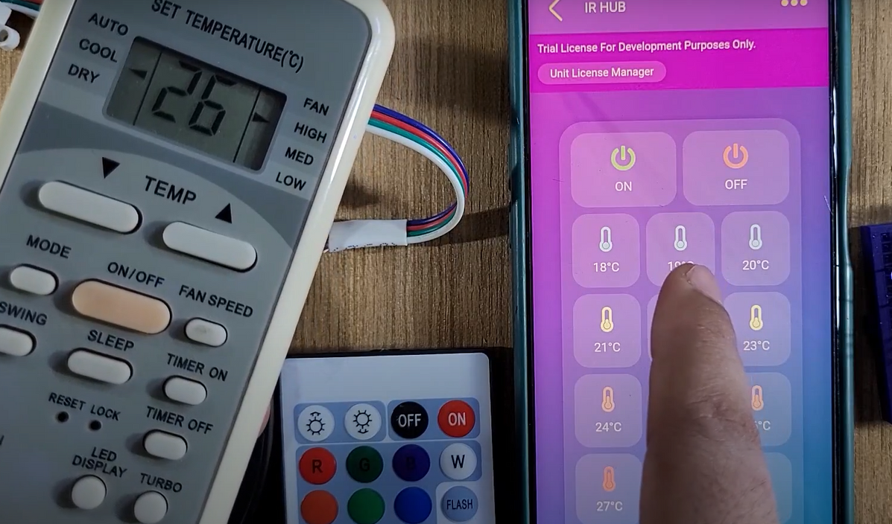
Write Code
IR Blaster Code: Use the IRremote library for sending/receiving IR codes.Write functions to transmit the stored IR codes of devices.
Wi-Fi & Cloud Communication: Set up the ESP8266/ESP32 to connect to Wi-Fi. Use software for communication between alexa/google assistant and arduino and IR Blaster system.
Store Device Codes
Record and store the IR codes of various devices in your Arduino sketch.

Slide 9
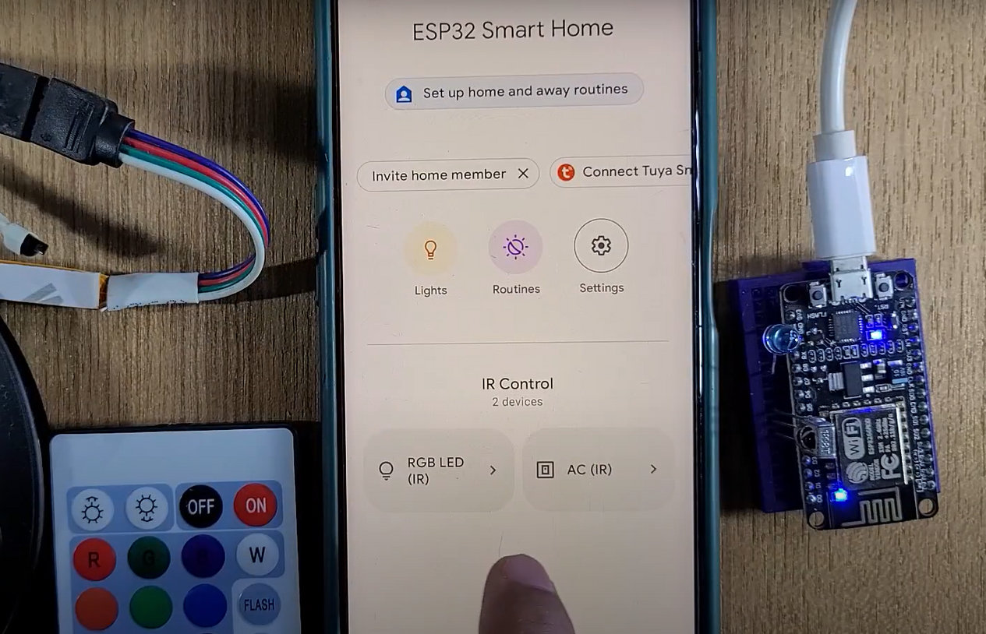
Set Up Alexa Skills/Google Actions
For Alexa:Create a custom Alexa skill using AWS Lambda and Amazon Developer Console.Connect it to your ESP8266/ESP32 via HTTP requests or Sinric Pro.
For Google Assistant:Create a custom action using Google Cloud Platform or use IFTTT to link voice commands to HTTP requests to your ESP8266/ESP32.
Write code on the Arduino to receive HTTP requests triggered by voice commands from Alexa or Google Assistant.
Program the Arduino to send specific IR signals when it receives these requests.

Slide 10
Contribution of Each Team Member
YOGESH KUMAR (2023CEB1055)
My work is to find the data about the project from the web and to find details about the project. How and when things should be done and In what way should be done. Like Project plan.
SHUBHAM(2023CEB1048)
Programming the Arduino to capture and transmit IR signals from remote controls. Installation including necessary libraries for IR control.
MANSHU(2023CEB1040)
Integration of Wi-Fi communication for remote access and voice command functionality and Programming the Arduino.

Slide 11
AMEEN KALER(2023CEB1023)
Perform extensive tests with Alexa/Google Assistant to ensure all commands are correctly executed.
ADITYA(2023CEB1022)
Circuit assembly and testing of hardware components for functionality.

Slide 12

Circuit assembly and testing of hardware components for functionality and reliability.
Software installation, including Arduino IDE and necessary libraries for IR control. Programming the Arduino to capture and transmit IR signals from remote controls.
WEEK01
WEEK02
Integration of Wi-Fi communication for remote access and voice command functionality.
WEEK03
Final testing and troubleshooting to ensure seamless operation of the voice-controlled system.
WEEK04

Slide 13
SUMMARY
Now, before first week we tried to learn about the project that what is the base and key concept of the project. And tried to find out that what are the learnings, hardwares, and other things are required.
We also made a plan, that how to complete the project in 4 weeks and what things are to be done in the following weeks.
THANK YOU

